Slide 1
How to construct a paragraph
45 minutes
Kat Lyons
Centre for Learner Success

Slide 2
Learning Outcomes
By the end of this session you will be able to:
Make informed decisions about paragraph length
Write effective opening sentences
Make your writing flow
Notes:
The session has two main aims: focusing of the importance of associations to improve learning and recall, and
How to build on associations through memory systems to memorise sets of facts.

Slide 3
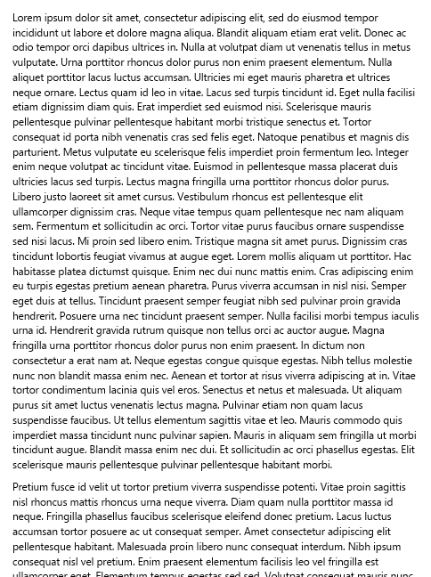
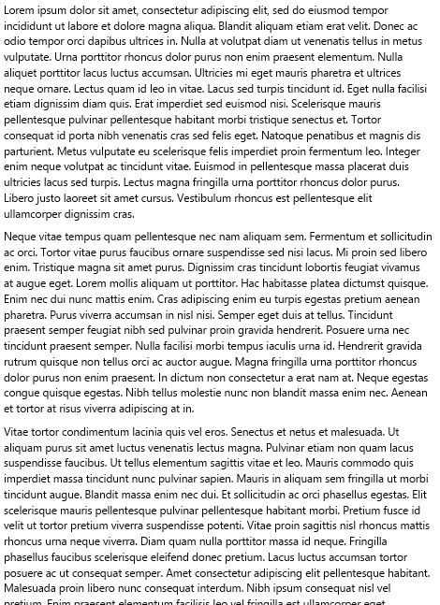
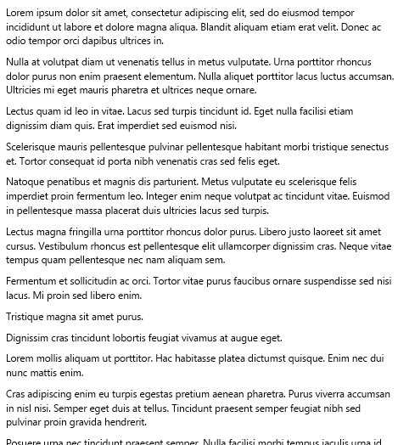
Part 1: Paragraph length
Which of these sets of paragraphs looks like they are a ‘good’ size?

Slide 4
Part 1: Paragraph length
How do you decide how long a paragraph should be?
Based on content (one point per paragraph)
Based on how much you need to support the point being made
(for an academic essay, each point will need several sentences of support).
Based on audience expectations and text type

Slide 5
Part 1: Paragraph length
How many words should a paragraph be for an essay?
For a business report?
For a news article?
Different text types have different expectations
Academic essays usually have paragraphs 150-250 words long.

Slide 6
Part 1: Paragraph length
Suggested number of paragraphs for common assignment lengths
500 words: 2-3 paragraphs
800 words: 3-5 paragraphs
1000 words: 4-7 paragraphs
1500 words: 6-10 paragraphs

Slide 7
Part 1: Paragraph length
The next slide shows a paragraph from an essay about the NZ government coalition of 2005 ...
(Miller, 2007)

Slide 8
Part 1: Paragraph length
First, think:
How many sentences and / or words do you expect in
this paragraph?
What do you expect in the first sentence?
What do you expect in the other sentences?

Slide 9
Part 1: Paragraph length
Formation of the new government, which was announced on 17 October, was not without controversy. Dunne’s and Peters’ objections had excluded the Greens from office, although the Greens’ support was acknowledged through acceptance of some of the party’s policy initiatives, and the offer of spokespersonship roles to the two co-leaders. The likely long-term stability of the new arrangements, involving a new executive cobbled together from a group of disparate and in some ways feuding parties, was questioned by many commentators.

Slide 10
Part 1: Paragraph length
How many sentences and / or words do you expect in
this paragraph?
  Three sentences, 80 words in this case
What do you expect in the first sentence?
  Clear claim
What do you expect in the other sentences?
  Support for that claim, and more details.

Slide 11
Part 1: Paragraph length
What if a paragraph is shorter than four sentences?
It could be ok …
Consider cutting it, or adding two or three more sentences to develop your argument.
What if a paragraph is more than eight sentences?
It could be ok …
Have another look in case some of the details are unnecessary, or it would be better split
Two well-focused paragraphs are better than one fuzzy one.

Slide 12
Part 2: Paragraph organisation
Ordering your ideas within the paragraph
  Topic / ‘Point’ sentences
  ‘Body’ of the paragraph
Flow

Slide 13
Topic sentences (aka Point sentences)
Here are the first sentences from some example paragraphs …
What do they have in common?
Another effect of climate change is the increased intensity of severe storms, as a result of higher ocean temperatures.
In contrast to Fayol’s pragmatic focus on management of organisations, Confucianism focuses on the maintenance of relationships in society as a whole.

Slide 14

Topic sentences (aka Point sentences)
Opening sentences act like a bridge between paragraphs

Slide 15


Topic sentences (aka Point sentences)
It’s not the only way to start a paragraph, but this ‘old → new’ pattern is a useful one.

Slide 16
‘Body’ of the paragraph
The rest of the paragraph supports and develops the claim/argument point which was made in the opening sentence. E.g …
HOW Confucianism focuses on the maintenance of relationships – and what this means for management.
HOW intense severe storms are, and how this compares with previous ones.
It does this through definition, explanation, argument, evidence, examples (and sometimes, exceptions).

Slide 17
Paragraph organisation
Point / Topic sentence: Makes a claim
Rest of the paragraph: Provides detail and supports that one claim
Do you know any acronyms or metaphors for paragraph structure?
Point, Illustration, Explanation/Conclusion/Implications?
Statement, Example, Explanation, Conclusion?

Slide 18
Paragraph organisation
Let’s look again at the paragraph about the 2005 coalition.
Can you see PIE (or SEXC, etc.) being used here?
How do the sentences flow?

Slide 19
While you consider this, I’ll pop the slides into the chat
Paragraph organisation
Formation of the new government, which was announced on 17 October, was not without controversy. Dunne’s and Peters’ objections had excluded the Greens from office, although the Greens’ support was acknowledged through acceptance of some of the party’s policy initiatives, and the offer of spokespersonship roles to the two co-leaders. The likely long-term stability of the new arrangements, involving a new executive cobbled together from a group of disparate and in some ways feuding parties, was questioned by many commentators.

Slide 20
While you consider this, I’ll pop the slides into the chat
Paragraph organisation
Claim (Point)
Formation of the new government, which was announced on 17 October, was not without controversy. Dunne’s and Peters’ objections had excluded the Greens from office, although the Greens’ support was acknowledged through acceptance of some of the party’s policy initiatives, and the offer of spokespersonship roles to the two co-leaders. The likely long-term stability of the new arrangements, involving a new executive cobbled together from a group of disparate and in some ways feuding parties, was questioned by many commentators.
Illustrations/ details that support
Explanation / implications / conclusion

Slide 21

Flow
How do you help readers follow your line of thinking?
Good, logical organisation in
the first place!
Showing the relationships between
ideas with ‘flow’ markers/generators

Slide 22
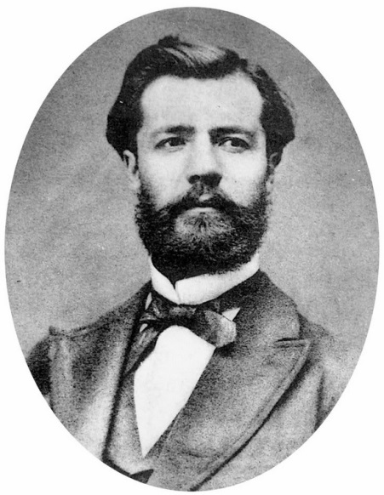
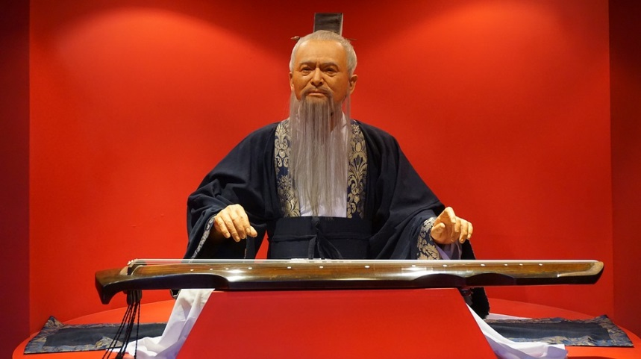
Paragraph organisation + flow
The next slide shows a paragraph from an essay comparing two leadership approaches – Fayol and Confucius.

Slide 23
Paragraph organisation + flow
The first and last sentences are in order …
Type in the chat:
The correct order for the other sentences (eg B, D, A, C) =)

Slide 24
In contrast to Fayol’s pragmatic focus on management of organisations, Confucianism focuses on the maintenance of relationships in society as a whole.
A) Therefore, in an organisational context, leaders need to maintain a harmonious environment in which employees willingly accept their duties.
B) Leadership is central to all of these relationships because society is viewed as hierarchical, with each member typically having power over some, while being subservient to others.
C) Social relationships are categorised into five types: emperor-subject, father-son, husband-wife, older-young brother, and friend-friend.
D) The potential for power struggles means that harmony is seen as a key objective in order to secure the sustainability of the society.
This requires leaders to maintain a delicate balance between obligations from and rewards to their team members.
Paragraph organisation
The first and last sentences are in order …
Type in the chat:
The correct order for the other sentences (eg B, D, A, C) =)

Slide 25
FEEDBACK
The original sequence was:
C) Social relationships are categorised into five types: emperor-subject, father-son, husband-wife, older-young brother, and friend-friend.
B) Leadership is central to all of these relationships because society is viewed as hierarchical, with each member typically having power over some, while being subservient to others.
D) The potential for power struggles means that harmony is seen as a key objective in order to secure the sustainability of the society.
A) Therefore, in an organisational context, leaders need to maintain a harmonious environment in which employees willingly accept their duties.
Paragraph organisation
The first and last sentences are in order …
Type in the chat:
The correct order for the other sentences (eg B, D, A, C) =)

Slide 26
Paragraph organisation + flow
Looking at this paragraph about leadership types …
What is the main way in which the topic is developed?
Definition, explanation, argument, evidence, examples (exceptions)?
How do the sentences flow?

Slide 27
In contrast to Fayol’s pragmatic focus on management of organisations, Confucianism focuses on the maintenance of relationships in society as a whole (de Bettignies et al., 2011). Social relationships are categorised into five types: emperor-subject, father-son, husband-wife, older-younger brother, and friend-friend (Li, 1984). Leadership is central to all of these relationships because society is viewed as hierarchical, with each member typically having power over some, while being subservient to others. The potential for power struggles means that harmony is seen as a key objective in order to secure the sustainability of the society (Ip, 2009). Therefore, in an organisational context, leaders need to maintain a harmonious environment in which employees willingly accept their duties (Tsui et al., 2004).This requires leaders to maintain a delicate balance between obligations from and rewards to their team members (Zhang et al., 2005).
Claim (Point)
Illustrations / details that support
Explanation / implications / conclusion

Slide 28
Flow
Three ways to generate flow …
Repetition (and some variation) of topic vocabulary:
Keeps the focus on the same topic
Back-reference devices:
Using ‘this’ / ‘these’ / ‘such’, etc. means that each sentence builds on the one before, helping your argument move forward
Signpost words:
Words or phrases like ‘Moreover’ or ‘On the other hand’ highlight important steps in the argument – but should not be used too much.

Slide 29
Note down the signposts, back-references, or repeated words/phrases/concepts you notice in this paragraph
In contrast to Fayol’s pragmatic focus on management of organisations, Confucianism focuses on the maintenance of relationships in society as a whole. Social relationships are categorised into five types: emperor-subject, father-son, husband-wife, older-young brother, and friend-friend. Leadership is central to all of these relationships because society is viewed as hierarchical, with each member typically having power over some, while being subservient to others. The potential for power struggles means that harmony is seen as a key objective in order to secure the sustainability of the society. Therefore, in an organisational context, leaders need to maintain a harmonious environment in which employees willingly accept their duties. This requires leaders to maintain a delicate balance between obligations from and rewards to their team members.

Slide 30
Signpost words … highlight key relationships / ‘moves’ in the argument (e.g. important links, contrasts, limitations, etc)
In contrast to Fayol’s pragmatic focus on management of organisations, Confucianism focuses on the maintenance of relationships in society as a whole. Social relationships are categorised into five types: emperor-subject, father-son, husband-wife, older-young brother, and friend-friend. Leadership is central to all of these relationships because society is viewed as hierarchical, with each member typically having power over some, while being subservient to others. The potential for power struggles means that harmony is seen as a key objective in order to secure the sustainability of the society. Therefore, in an organisational context, leaders need to maintain a harmonious environment in which employees willingly accept their duties. This requires leaders to maintain a delicate balance between obligations from and rewards to their team members.

Slide 31
This strategy keeps the focus tightly on the
topic and helps to knit the text together.
Repetition and variation of topic word(s)
In contrast to Fayol’s pragmatic focus on management of organisations, Confucianism focuses on the maintenance of relationships in society as a whole. Social relationships are categorised into five types: emperor-subject, father-son, husband-wife, older-young brother, and friend-friend. Leadership is central to all of these relationships because society is viewed as hierarchical, with each member typically having power over some, while being subservient to others. The potential for power struggles means that harmony is seen as a key objective in order to secure the sustainability of the society. Therefore, in an organisational context, leaders need to maintain a harmonious environment in which employees willingly accept their duties. This requires leaders to maintain a delicate balance between obligations from and rewards to their team members.

Slide 32
Back-reference: each sentence builds on the previous one(s) – another example of the ‘old-new’ pattern we saw earlier.
In contrast to Fayol’s pragmatic focus on management of organisations, Confucianism focuses on the maintenance of relationships in society as a whole. Social relationships are categorised into five types: emperor-subject, father-son, husband-wife, older-young brother, and friend-friend. Leadership is central to all of these relationships because society is viewed as hierarchical, with each member typically having power over some, while being subservient to others. The potential for power struggles means that harmony is seen as a key objective in order to secure the sustainability of the society. Therefore, in an organisational context, leaders need to maintain a harmonious environment in which employees willingly accept their duties. This requires leaders to maintain a delicate balance between obligations from and rewards to their team members.

Slide 33
Organise from
General → Specific
Problem→ Solution
In contrast to Fayol’s pragmatic focus on management of organisations, Confucianism focuses on the maintenance of relationships in society as a whole. Social relationships are categorised into five types: emperor-subject, father-son, husband-wife, older-young brother, and friend-friend. Leadership is central to all of these relationships because society is viewed as hierarchical, with each member typically having power over some, while being subservient to others. The potential for power struggles means that harmony is seen as a key objective in order to secure the sustainability of the society. Therefore, in an organisational context, leaders need to maintain a harmonious environment in which employees willingly accept their duties. This requires leaders to maintain a delicate balance between obligations from and rewards to their team members.

Slide 34
Bringing it together
What do you like or dislike about this paragraph?

Slide 35
Another effect of climate change is the increased intensity of severe storms, as a result of higher ocean temperatures (EPA, 2016). Severe storms (variously known as hurricanes, typhoons or cyclones) can extend more than a hundred kilometres in diameter, with winds gusting to over 200kph (Snowdon, 2006). So great, in fact, is the energy released by a severe storm that it has been estimated to exceed the total energy consumed by humankind throughout the world in one year (Fowles, 2001). Together with other extreme weather events, storms have been responsible for nearly two million deaths over the last thirty years. They also cause economic losses estimated at $US150 billion each year (World Bank, 2013). These impacts are not restricted to the tropics. Tropical storms have been known to reintensify as they reach New Zealand. For instance, in 1968, Cyclone Gisele produced gusts of up to 270kph in Wellington and led to the sinking of the ferry Wahine, with 51 fatalities (Sinclair, 2002).

Slide 36
Summary
In academic writing, paragraphs are typically 4-8 sentences long (about 150 to 250 words).
They should only be on one point at a time
Opening (topic) sentences indicate the main argument of a paragraph, and act like a bridge between paragraphs.
‘PIE’ is a useful way to organise paragraphs – make sure the opening claim is supported!
Paragraphs can flow better if you use back-references and signpost words, etc.

Slide 37
Need help?
We have a range of free services to help you with your assignment writing and study skills
Individual Support: Want to discuss your assignment before you hand it in? Want to discuss study skills (e.g. how to manage time)? Book an appointment at https://massey-nz.libcal.com/
Pre-Reading Service: Submit a draft assignment and receive individual written feedback on your assignment’s structure, focus, referencing, and use of sources. This service is available to first year internal and all distance students. You can access the forum through the Academic Writing and Learning Support site on your Stream homepage.
Workshops: Seminars and workshops are run on campus and online, which can help you with writing and study skills, such as essay writing, referencing, and writing research proposals. See here for programmes and registration details. See http://owll.massey.ac.nz/about-OWLL/workshops.php
Academic Q+A forum: Ask our consultants a question about academic writing and/or study skills. The Q & A forum is a place for students to receive help with quick, study-related questions. You can access the forum through the Academic Writing and Learning Support site on your Stream homepage.
OWLL: Information about academic writing and study skills, including assignment planning, essays, reports, and referencing. Go to http://owll.massey.ac.nz/index.php
Disability Services: A range of services and support for students who have health and disability issues that are impacting their study.
Pacific Massey: Whether studying as an internal or distance student, you can also access Learning support from the Pasifika Learning Advisors.
Te Rau Tauawhi: Ko tā Te Rau Tauawhi he āwhina i ngā tauira Māori ki te tuku aromatawatai ki Te Reo Māori, ki te tautoko hoki i ngā āhuatanga whakarite tuhinga. The Te Rau Tauawhi Māori Student Centre can help you to submit your assignment in Te Reo Māori and provide general assignment structure support.

Slide 38
The Centre for Learner Success
We help students with…
Assignment writing advice
Academic writing development
Understanding assignment questions
Citing and writing references
Enhancing study skills, like:
  Reading techniques
  Notetaking
  Time management skills
  Critical thinking, reading & writing
Campus locations
Palmerston North – Manawatū
Student Centre Level 2, Manawatū Campus
+ 64 6 951 6540
learnersuccess@massey.ac.nz
Albany
Level 3, Library, Albany Campus
+ 64 9 212 7117
learnersuccess@massey.ac.nz
Wellington
Block 5, Ground Floor (Level A in the Library), Wellington Campus
+64 4 801 5799 extn: 63389
learnersuccess@massey.ac.nz
TO BOOK AN APPOINTMENT,
GO TO:
https://massey-nz.libcal.com/

