Slide 1
How to improve your memory
30-45 min session
Kat Lyons
Mātanga Ako (Learning Consultant)

Slide 2
Learning Outcomes
By the end of this session you will be able to:
Use associations to reinforce learning and recall
Use memory systems to memorise sets of facts
Notes:
The session has two main aims: focusing of the importance of associations to improve learning and recall, and
How to build on associations through memory systems to memorise sets of facts.

Slide 3
Different types of learning
Analyse, evaluate, create, criticise
Recount, recall, describe
Which set of skills uses deeper thinking?
Which set uses memorisation skills?
Are both types of learning / knowledge useful at uni?

Slide 4
Different types of learning
Analyse, evaluate, create, criticise
Deep learning
Takes real engagement with the concepts
Many assignments use these skills – this is the main purpose of uni level study
Recount, recall, describe
More surface-level learning
Can be useful ‘building blocks’ for the later analysis (e.g. knowing what the theories are before you evaluate them)
Can be in short-answer or multichoice tests, or in language learning
Memory systems can help here ← the focus of today’s session

Slide 5
Memory test
How many of these can you remember?
What you ate for lunch yesterday
An unpleasant experience at primary school
Where the washing powder is in your local supermarket
Your student ID number
The planets from the Sun outwards
Write in the chat box:
The number of things you remember (e.g. 3)
Also:
Why do we manage to recall some things easily and not others?

Slide 6
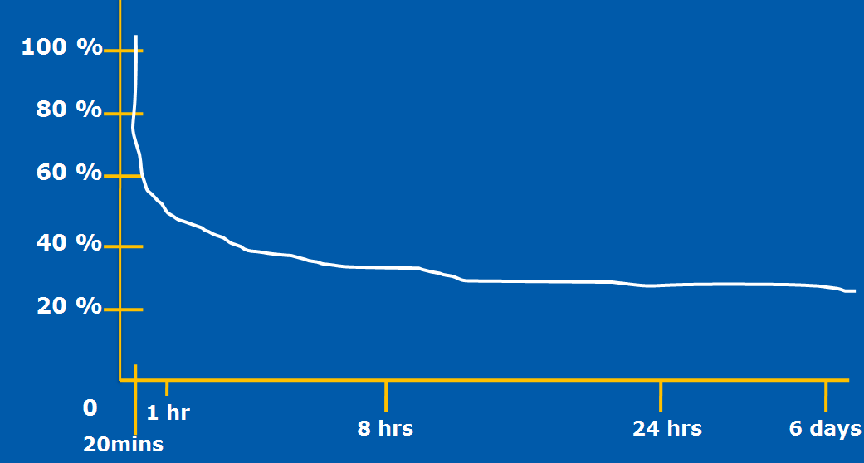
Why we forget
We remember information that had strong associations at the time we learnt it and / or is frequently used.
We are also very good at forgetting in everyday life – and we carry that across into learning.
The Forgetting Curve (Ebbinghaus, 1913)

Slide 7
Spaced recall
You can beat the forgetting curve with spaced recall: little and often
Building memory capacity typically relies on strengthening the associations you make when first learning information – and that’s the main focus of the rest of this session

Slide 8
Spaced recall
Do the best with what you have!
Ideally, revise
1 hour,
1 day,
1 week, and
1 month
after learning something
This is the most efficient use of time
If you can’t do the ‘ideal’, work with what you can do (e.g. 10 mins after the lesson or at lunchtime, 30 minutes after dinner)

Slide 9
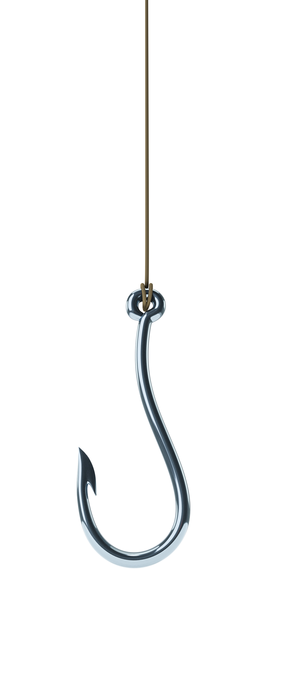
Making stronger
associations
An association connects two things:
A target word or fact
This is unfamiliar information – and at uni, usually abstract and / or technical – which you are trying to learn
A hook
This is something familiar – typically physical – that you can link to the target word or fact so that you can recall it later

Slide 10
Visualisation
An effective way to create a hook is through visualisation:
It’s easier to remember pictures than words
The mind cannot distinguish between what is real and what is imaginary
However, success is the result of recent, frequent and successful practice

Slide 11
Steps to effective visualisation
Close your eyes
Relax
Create and manipulate sense impressions
Deepen and intensify
Suspend judgement
Practise often

Slide 12
Example
In Human Development, you may need to remember the four stages of cognitive development proposed by Piaget:
Sensorimotor (birth to two years)
Preoperational (two to seven years)
Concrete operational (seven to eleven years)
Formal operational (eleven years +)

Slide 13
Example
An association can be a more familiar word that sounds like the target word.
For example, for ‘sensorimotor’, I might think of a motor car on a pile of coins.
Then, I close my eyes and visualise this ‘hook’ I’ve made.

Slide 14
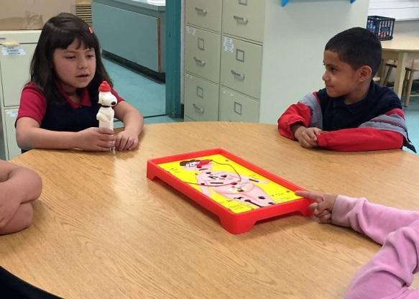
Task
Write in the chat box:
Your idea for a hook for Piaget’s next stage:
Preoperational (two to seven years)
Feedback:
I thought of preschool kids playing the ‘Operation’ game

Slide 15
Linking your associations
In academic studies, we often need to learn sets or sequences of words or facts
Examples include:
Areas of the brain
Components of the marketing mix
Conditions for a legal contract
Write in the chat box:
One set or sequence of words or facts that it’s important to remember in a subject you are studying

Slide 16
Linking your associations
Memory systems (aka mnemonics) can help you to remember sets or sequences of words or facts
We will look at:
Acrostics
Stories
Loci (places)
There are others, e.g. Rhymes/Songs Chunking (e.g. 027-325-xyz)
- Try searching for new techniques =)

Slide 17
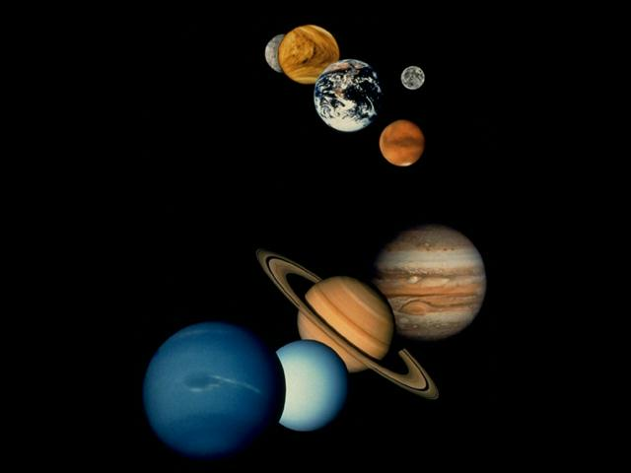
Acrostics
This is a simple system of making a sentence using the first letters of each word in a sequence.
Write in the chat box if you learnt the traditional one for the planets (including Pluto!):
Mercury Venus Earth Mars Jupiter Saturn Uranus Neptune Pluto
My Vehicle Encounters Many Jerks Struggling Up Neglected Paths
In this case, the ‘hooks’ are the words in the
sentence AND the sequence of the sentence itself.

Slide 18
Task
I will pop the slides in chat while you think about this =)
Write in the chat box:
An acrostic for Piaget’s four stages of cognitive development:
Sensorimotor
Preoperational
Concrete operational
Formal operational
My example:
I came up with: Stages Piaget Cleverly Formulated

Slide 19
Stories
First: make associations with words or facts and Then: make a story based on the original sequence. E.g.: if you need to memorise the most common elements (in order) found in rocks.
The first step is to make a ‘hook’ for each item in the list:
Oxygen = ox
Silicon = Steve Jobs
Aluminium = aluminium foil
Iron = clothes iron
Calcium = calculator
Sodium = drink of soda stream
Potassium = pot
Magnesium = magnet

Slide 20
Stories
Then you make up a story (as absurd as you like) involving the ‘hooks’ in sequence:
ox: an ox is walking along the road
Jobs: riding the ox is Steve Jobs
aluminium foil: he is wearing a shirt made from aluminium foil
clothes iron: the shirt is rumpled, so he starts ironing it
calculator: a calculator falls out of the pocket
soda stream: it falls down and lands by a drink of soda stream
pot: the drink of soda stream is in a large iron pot
magnet: stuck on the side of the pot is a huge magnet
Close your eyes and visualise the story as you say it – and go over it a few times till you recall it.

Slide 21
Loci (places)
When doing Loci, instead of a story, you visualise each ‘hook’ in a particular place as you follow a familiar route, like the rooms in your home, in a fixed order.
Bed 3
Bed 2
Toilet
Bed 1
Bathroom
Hallway
Kitchen
Dining Room
Garage
Lounge
Front door
Driveway

Slide 22
Example
Let’s imagine you have to memorise the 12 cranial nerves…
olfactory optic oculomotor trochlear
trigeminal abducens facial auditory
glossopharyngeal vagus spinal accessory hypoglossal
The first step is to create visual ‘hooks’. Write in the text box if any spring to mind.
Here are some we prepared earlier!
olfactory = oil factory facial = face
optic = optician auditory = audio tape
oculomotor = motor car glossopharyngeal = lipgloss
trochlear = truck vagus = veggies
trigeminal = three gems spinal accessory = spine
abducens = duck hypoglossal = hypodermic needle

Slide 23
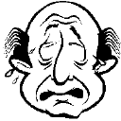
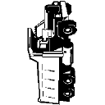
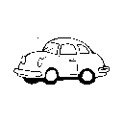
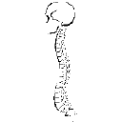
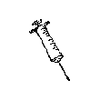
Then you visualise one in each room as you go round the house
B3
B2
Hallway
Toilet
Bathroom
B1
Garage
Dining room
Lounge
Kitchen
Driveway
Entry
Notes:
So all we need to do is take a walk around our pre-prepared journey and each of those rooms we visualise the different hooks. So we go in and …. [click through 12 different rooms and images]
The trick is to make these memorable to YOU. For example, if I had to do this, My version would look very different: … [see next slide]

Slide 24
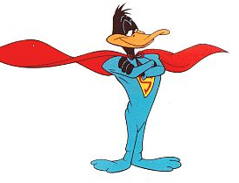
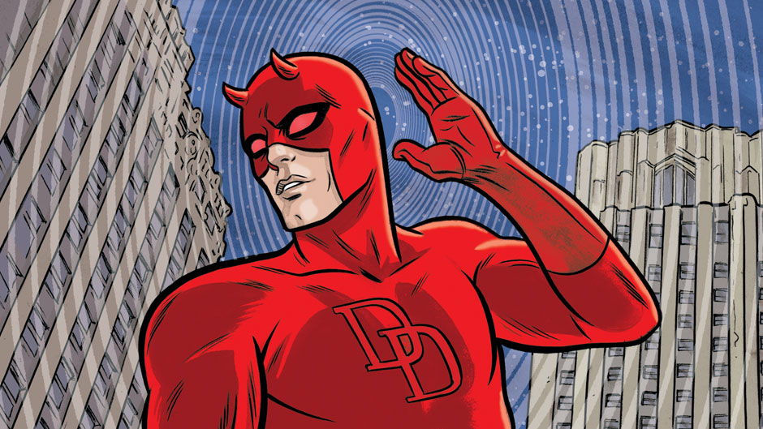
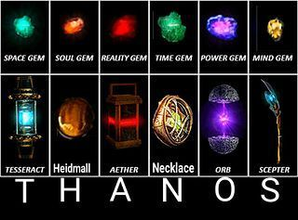
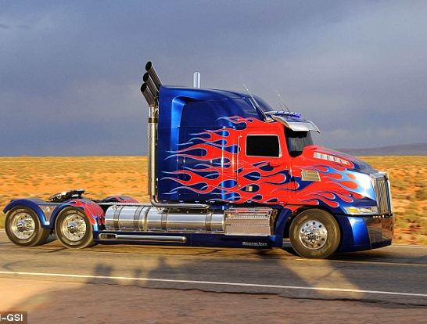
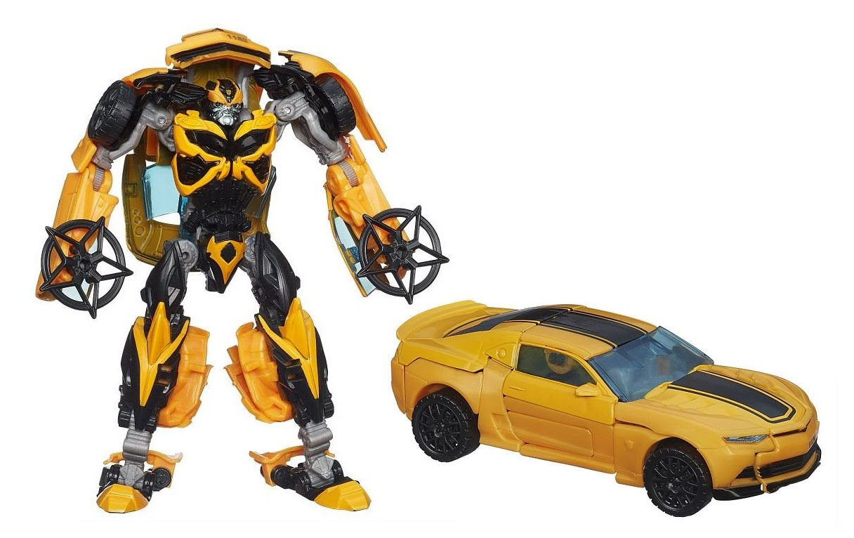
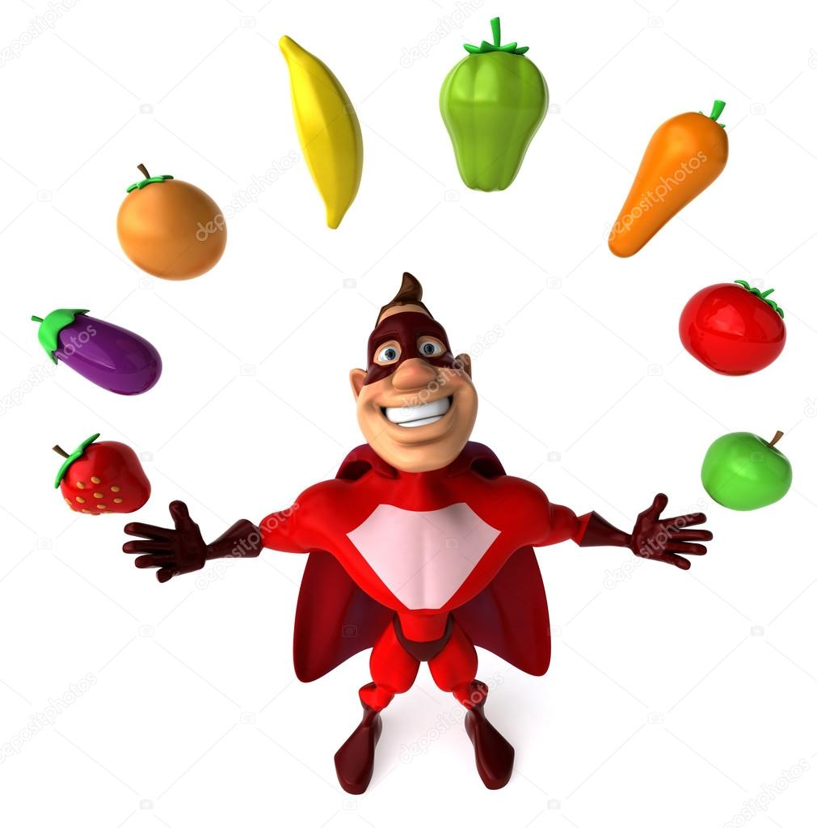
Do what works for YOU!
The weirder / funnier the hook and the more familiar the route, the better
B3
B2
Toilet
Bathroom
Hallway
B1
Garage
Dining room
Lounge
Kitchen
Driveway
Entry
Notes:
Olfactory = Wolverine – (Xmen; enhanced sense of smell)
Optic = Cyclops - XMen
Oculomotor = bumblebee – Transformers
trochlear = Optimus Prime - Transformers
Trigeminal = Infinity gems – Marvel movies
Abducens = Super duck – Looney Toons
Facial = The Face – A-team
Auditory = DareDevil – Marvel movies
Glossopharyngeal = Gloss – Marvel comic book hero
Vagus = Super Vege Man
spinal accessory = Super Man – DC movies
Hypoglossal = #HypoHeroes – Website for World Diabetes Day
(Based off of movies and super heros)
These are examples of stories that take you along a predetermined journey, which get practiced a few times before they stick properly.
The point being that sets of facts like this are not just easier but more fun to learn when you use a strategy like this.

Slide 25
Can you recall?
The second most common element found in rocks
The third Piagetian stage of cognitive development
The first cranial nerve
Write your answers in chat:
Answers:
Silicon (Jobs)
Concrete operational (Stages Piaget Cleverly Formulated)
Olfactory (Oil factory in the entryway)

Slide 26
In this session we’ve discussed how to …
Use associations to reinforce learning and recall
Use frequency / spaced recall to beat the forgetting curve
Use memory systems to memorise sets of facts
For more advice and resources, look under ‘Academic Writing and Learning Support’ on Stream
The library has books on learning and memory. Use the search box or ask a librarian for advice.
I’m here for questions – type in chat or unmute yourself =)
For more study and writing tips, please make an appointment! https://massey-nz.libcal.com/

Slide 27
Need help? We have a range of free services to help you with your assignment writing and study skills:
Individual Support: Want to discuss your assignment before you hand it in? Want to discuss study skills (e.g. how to manage time)? Book an appointment at https://massey-nz.libcal.com/
Pre-Reading Service: Submit a draft assignment and receive individual written feedback on your assignment’s structure, focus, referencing, and use of sources. This service is available to first year internal and all distance students. You can access the forum through the Academic Writing and Learning Support site on your Stream homepage.
Workshops: Seminars and workshops are run on campus and online, which can help you with writing and study skills, such as essay writing, referencing, and writing research proposals. See here for programmes and registration details. See http://owll.massey.ac.nz/about-OWLL/workshops.php
Academic Q+A forum: Ask our consultants a question about academic writing and/or study skills. The Q & A forum is a place for students to receive help with quick, study-related questions. You can access the forum through the Academic Writing and Learning Support site on your Stream homepage.
OWLL: Information about academic writing and study skills, including assignment planning, essays, reports, and referencing. Go to http://owll.massey.ac.nz/index.php
Disability Services: A range of services and support for students who have health and disability issues that are impacting their study.
Pacific Massey: Whether studying as an internal or distance student, you can also access Learning support from the Pasifika Learning Advisors.
Te Rau Tauawhi: Ko tā Te Rau Tauawhi he āwhina i ngā tauira Māori ki te tuku aromatawatai ki Te Reo Māori, ki te tautoko hoki i ngā āhuatanga whakarite tuhinga. The Te Rau Tauawhi Māori Student Centre can help you to submit your assignment in Te Reo Māori and provide general assignment structure support.

Slide 28
The Centre for Learner Success
We help students with…
Assignment writing advice
Academic writing development
Understanding assignment questions
Citing and writing references
Enhancing study skills, like:
Reading techniques
Notetaking
Time management skills
Critical thinking, reading & writing
Campus locations
Palmerston North – Manawatū Student Centre Level 2, Manawatū Campus
+ 64 6 951 6540
learnersuccess@massey.ac.nz
Albany Level 3, Library, Albany Campus + 64 9 212 7117
learnersuccess@massey.ac.nz
Wellington Block 5, Ground Floor (Level A in the Library), Wellington Campus +64 4 801 5799 extn: 63389
learnersuccess@massey.ac.nz
TO BOOK AN APPOINTMENT,
GO TO:
https://massey-nz.libcal.com/

